Slide 1

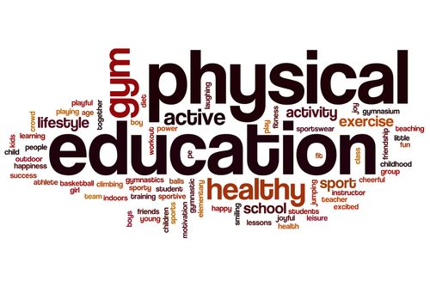
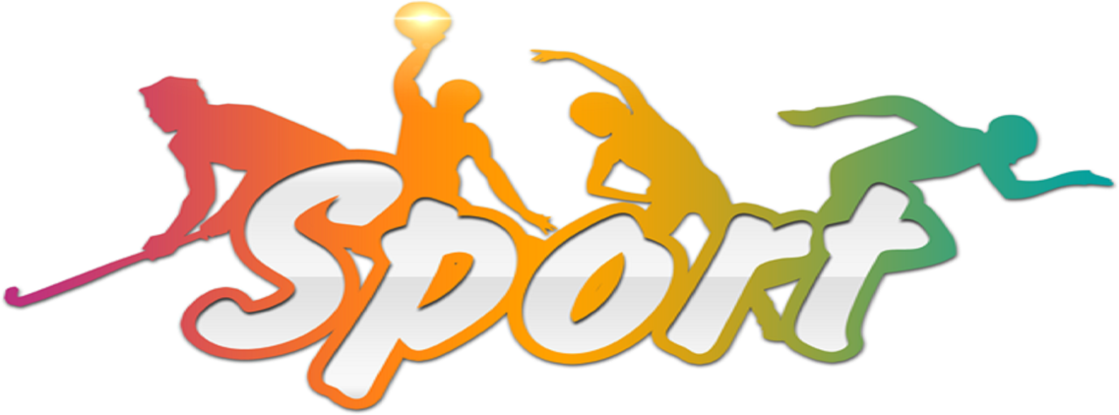
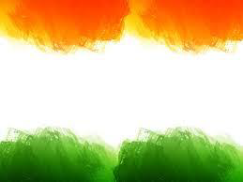
SHRI GURU GOBIND SINGH JI GOVT. COLLEGE,
PAONTA SAHIB, SIRMOUR (H.P)

Slide 2
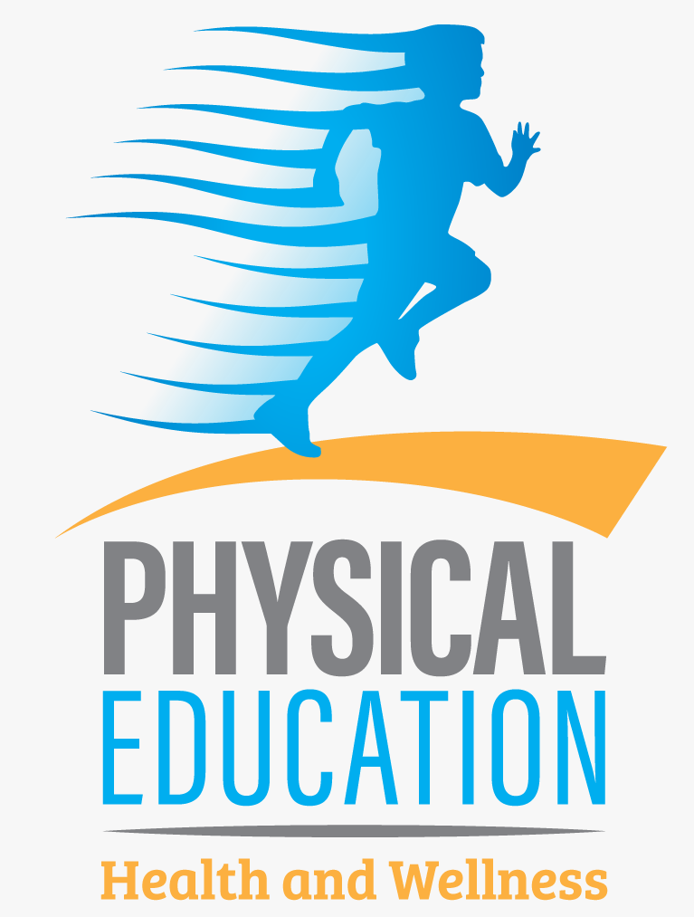
B.A. 2nd YEAR
COURSE NAME: HUMAN ANATOMY AND PHYSIOLOGY
COURSE CODE: PED201TH

Slide 3
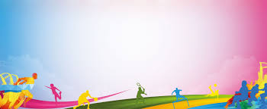
DIGESTIVE SYSTEM

Slide 4
TOPICS TO BE COVERED
DIGESTIVE SYSTEM
ORGANS OF DIGESTIVE SYSTEM
  MOUTH
  ESOPHAGUS
  STOMACH
  SMALL INTESTINE
  PANCREAS
  LIVER
  GALLBLADDER
  COLON
  RECTUM
  ANUS

Slide 5
DIGESTIVE SYSTEM
The organs that take in food and liquids and break them down into substances that the body can use for energy, growth, and tissue repair.
Waste products the body cannot use leave the body through bowel movements.
The digestive system includes the mouth, pharynx (throat), esophagus, stomach, small intestine, large intestine, rectum, and anus.
It also includes the salivary glands, liver, gallbladder, and pancreas, which make digestive juices and enzymes that help the body digest food and liquids. Also called gastrointestinal system.

Slide 6
Anatomy of the digestive system.
The digestive system is made up of organs that are important for digesting food and liquids.
These include the mouth, pharynx (throat), esophagus, stomach, small intestine, large intestine, rectum, and anus.
The digestive system also includes the salivary glands, liver, gallbladder, and pancreas, which make digestive juices and enzymes that help with digestion.

Slide 7
ORGANS OF DIGESTIVE SYSTEM
The main organs that make up the digestive system (in order of their function) are the mouth, esophagus, stomach, small intestine, large intestine, rectum and anus.
Helping them along the way are the pancreas, gall bladder and liver.
Here’s how these organs work together in your digestive system.

Slide 8
MOUTH
The mouth is the beginning of the digestive tract. In fact, digestion starts before you even take a bite.
Your salivary glands get active as you see and smell that pasta dish or warm bread. After you start eating, you chew your food into pieces that are more easily digested.
Your saliva mixes with the food to begin to break it down into a form your body can absorb and use.
When you swallow, your tongue passes the food into your throat and into your esophagus.

Slide 9
ESOPHAGUS
Located in your throat near your trachea (windpipe), the esophagus receives food from your mouth when you swallow.
The epiglottis is a small flap that folds over your windpipe as you swallow to prevent you from choking (when food goes into your windpipe).
A series of muscular contractions within the esophagus called peristalsis delivers food to your stomach. But first a ring-like muscle at the bottom of your esophagus called the lower esophageal sphincter has to relax to let the food in.
The sphincter then contracts and prevents the contents of the stomach from flowing back into the esophagus. (When it doesn’t and these contents flow back into the esophagus, you may experience acid reflux or heartburn.)

Slide 10
STOMACH
The stomach is a hollow organ, or "container," that holds food while it is being mixed with stomach enzymes.
These enzymes continue the process of breaking down food into a usable form.
Cells in the lining of your stomach secrete a strong acid and powerful enzymes that are responsible for the breakdown process.
When the contents of the stomach are processed enough, they’re released into the small intestine.

Slide 11
SMALL INTESTINE
Made up of three segments — the duodenum, jejunum, and ileum — the small intestine is a 22-foot long muscular tube that breaks down food using enzymes released by the pancreas and bile from the liver. Peristalsis also works in this organ, moving food through and mixing it with digestive juices from the pancreas and liver.
The duodenum is the first segment of the small intestine. It’s largely responsible for the continuous breaking-down process. The jejunum and ileum lower in the intestine are mainly responsible for the absorption of nutrients into the bloodstream.
Contents of the small intestine start out semi-solid and end in a liquid form after passing through the organ. Water, bile, enzymes and mucus contribute to the change in consistency. Once the nutrients have been absorbed and the leftover-food residue liquid has passed through the small intestine, it then moves on to the large intestine (colon).

Slide 12
PANCREAS
The pancreas secretes digestive enzymes into the duodenum that break down protein, fats and carbohydrates.
The pancreas also makes insulin, passing it directly into the bloodstream.
Insulin is the chief hormone in your body for metabolizing sugar.

Slide 13
LIVER
The liver has many functions, but its main job within the digestive system is to process the nutrients absorbed from the small intestine. Bile from the liver secreted into the small intestine also plays an important role in digesting fat and some vitamins.
The liver is your body's chemical "factory." It takes the raw materials absorbed by the intestine and makes all the various chemicals your body needs to function.
The liver also detoxifies potentially harmful chemicals. It breaks down and secretes many drugs that can be toxic to your body.

Slide 14
GALLBLADDER
The gallbladder stores and concentrates bile from the liver, and then releases it into the duodenum in the small intestine to help absorb and digest fats.

Slide 15
COLON
The colon is responsible for processing waste so that emptying your bowels is easy and convenient. It’s a 6-foot long muscular tube that connects the small intestine to the rectum.
The colon is made up of the cecum, the ascending (right) colon, the transverse (across) colon, the descending (left) colon, and the sigmoid colon, which connects to the rectum.
Stool, or waste left over from the digestive process, is passed through the colon by means of peristalsis, first in a liquid state and ultimately in a solid form. As stool passes through the colon, water is removed. Stool is stored in the sigmoid (S-shaped) colon until a "mass movement" empties it into the rectum once or twice a day.
It normally takes about 36 hours for stool to get through the colon. The stool itself is mostly food debris and bacteria. These “good” bacteria perform several useful functions, such as synthesizing various vitamins, processing waste products and food particles and protecting against harmful bacteria. When the descending colon becomes full of stool, or feces, it empties its contents into the rectum to begin the process of elimination (a bowel movement).

Slide 16
RECTUM
The rectum is a straight, 8-inch chamber that connects the colon to the anus. The rectum's job is to receive stool from the colon, let you know that there is stool to be evacuated (pooped out) and to hold the stool until evacuation happens. When anything (gas or stool) comes into the rectum, sensors send a message to the brain. The brain then decides if the rectal contents can be released or not.
If they can, the sphincters relax and the rectum contracts, disposing its contents. If the contents cannot be disposed, the sphincter contracts and the rectum accommodates so that the sensation temporarily goes away.

Slide 17
ANUS
The anus is the last part of the digestive tract. It is a 2-inch long canal consisting of the pelvic floor muscles and the two anal sphincters (internal and external). The lining of the upper anus is able to detect rectal contents. It lets you know whether the contents are liquid, gas or solid.
The anus is surrounded by sphincter muscles that are important in allowing control of stool. The pelvic floor muscle creates an angle between the rectum and the anus that stops stool from coming out when it’s not supposed to. The internal sphincter is always tight, except when stool enters the rectum. This keeps us continent (prevents us from pooping involuntarily) when we are asleep or otherwise unaware of the presence of stool.
When we get an urge to go to the bathroom, we rely on our external sphincter to hold the stool until reaching a toilet, where it then relaxes to release the contents.

Slide 18


